Slide 1
Anomalous Edge Detection Using Conformal Prediction and Edge Exchangeable Model
Rui Luo
City University of Hong Kong

Slide 2
Conformal Prediction Requirement: Exchangeability
Joint probability of sequence of random variables
Markov
Exchangeable (De Finetti's theorem)
iid
Notes:
mixtures of i.i.d.: This Representation Theorem shows how statistical models emerge in a Bayesian context: under the hypothesis of exchangeability of the observables {Xi}∞i=1 , there is a parameter Θ such that, given the value of Θ , the observables are conditionally independent and identically distributed.

Slide 3
How to construct an exchangeable datasets for graphs?
Notes:
mixtures of i.i.d.: This Representation Theorem shows how statistical models emerge in a Bayesian context: under the hypothesis of exchangeability of the observables {Xi}∞i=1 , there is a parameter Θ such that, given the value of Θ , the observables are conditionally independent and identically distributed.

Slide 4
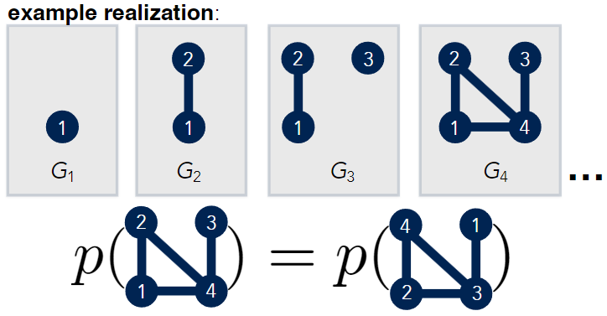
Exchangeable Models for Graphs
Node exchangeable model: Stochastic blockmodel (SBM), Graphon
Dense graphs only?
Edge exchangeable model: Diana Cai (2016), Harry Crane (2016), Sinead Williamson ADND (2016)
NIPS 2016, Diana Cai
Notes:
Aldous-Hoover theorem guarantees that these graphs are dense or empty with probability one, whereas many real-world graphs are sparse.

Slide 5
Notes:
The information contained in these edges depends on their sequential order.
https://en.wikipedia.org/wiki/Hierarchical_Dirichlet_process
Chong Wang, 2011: the base distribution is a symmetric Dirichlet over the vocabulary simplex;
Stick-breaking: This way we do not need to explicitly represent the document atoms
multiple document-level atoms can map to the same corpus-level atom

Slide 6
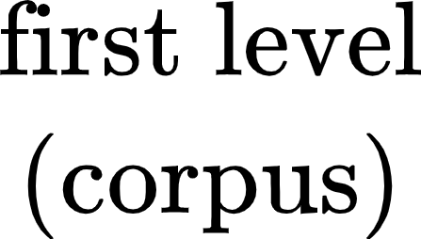
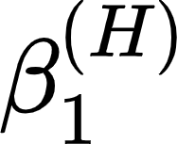
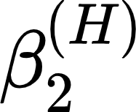
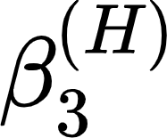
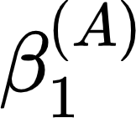
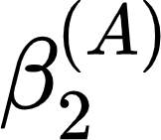
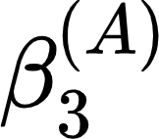
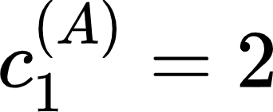
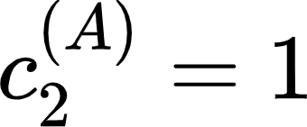
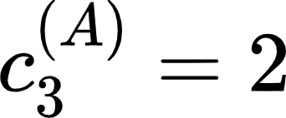
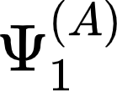
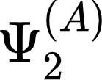
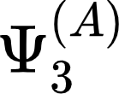
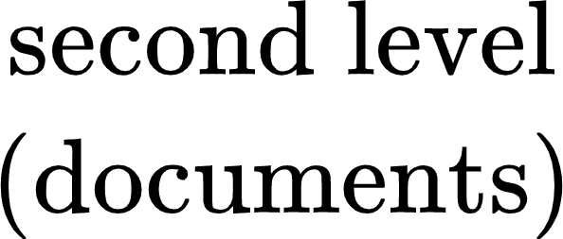
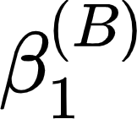
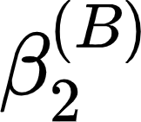
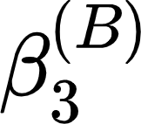
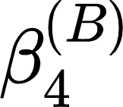
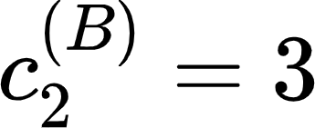
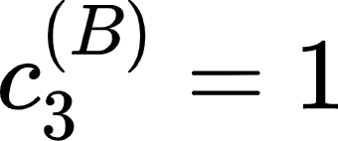
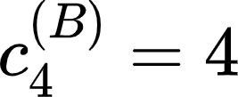
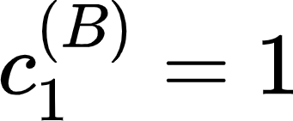
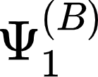
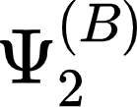
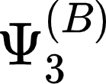
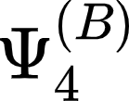
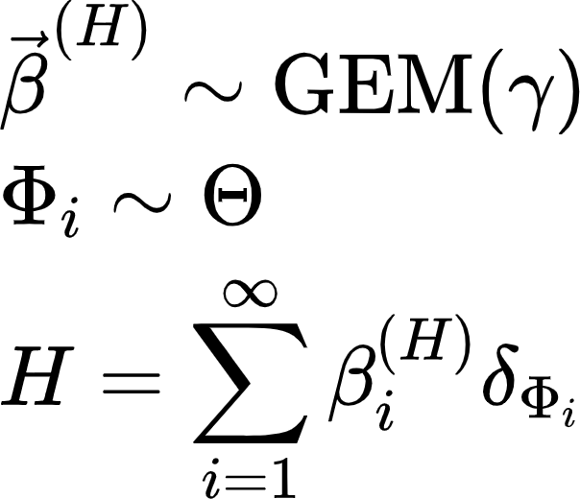
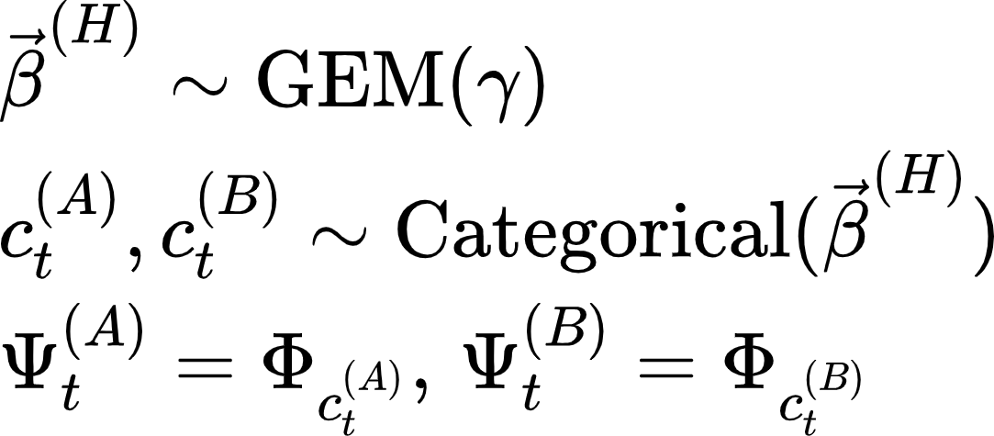
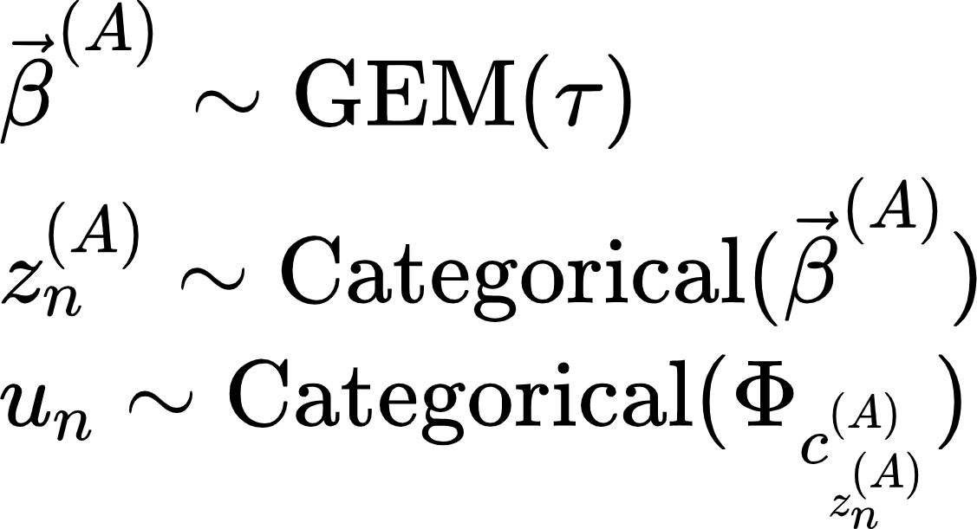

Slide 7
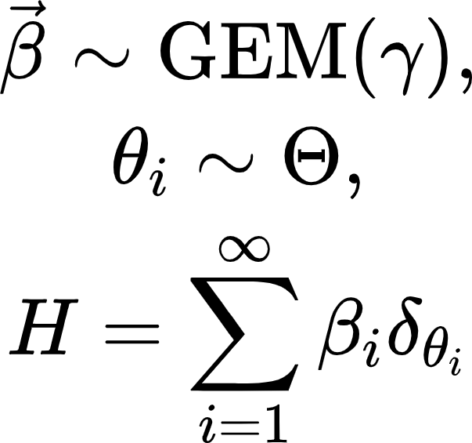
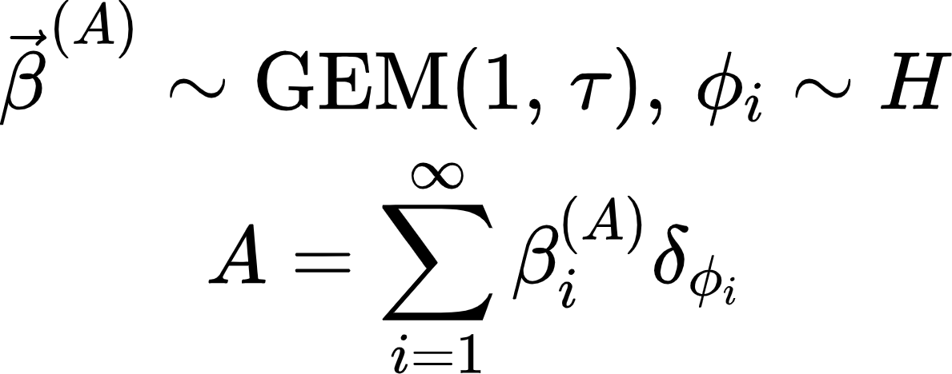
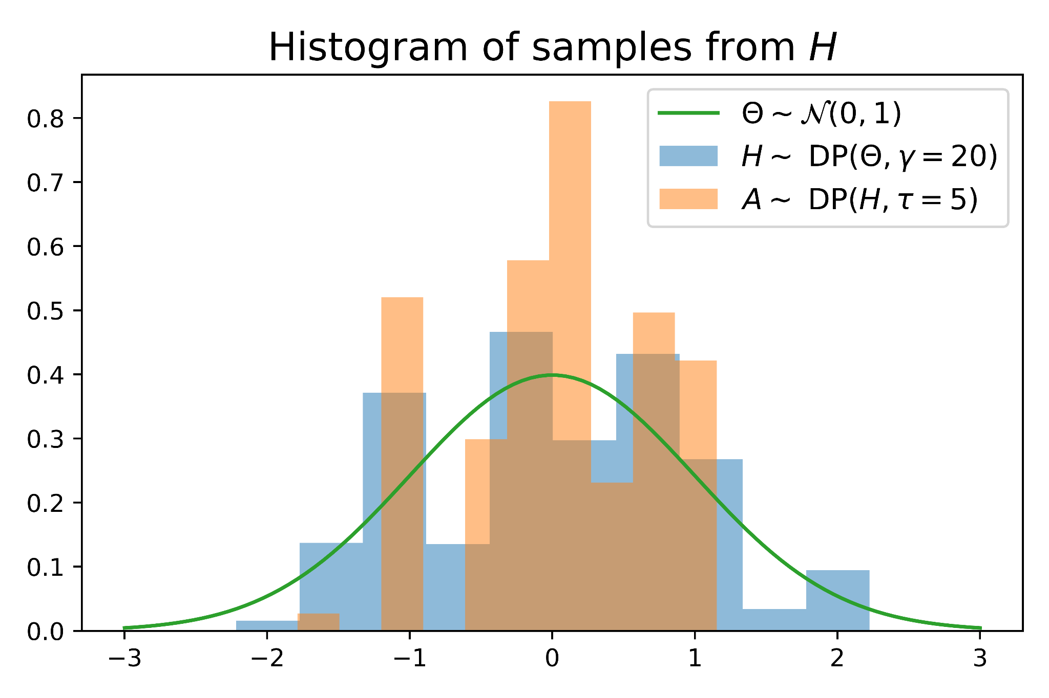
Notes:
The information contained in these edges depends on their sequential order.
https://en.wikipedia.org/wiki/Hierarchical_Dirichlet_process
Chong Wang, 2011: the base distribution is a symmetric Dirichlet over the vocabulary simplex;
In practice, however, drawing a concrete distribution is impossible, since its specification requires an infinite amount of information.
theta_i are samples from the base distribution Theta, \delta_theta_i is an indicator function centered on theta_i (zero everywhere except for) and the \beta _i are defined by a recursive scheme that repeatedly samples from the beta distribution.
HDP simulation code: https://colab.research.google.com/drive/1b9Cgkf7AiSdZdbN3VOjZVczCIzDFxked?usp=sharing

Slide 8
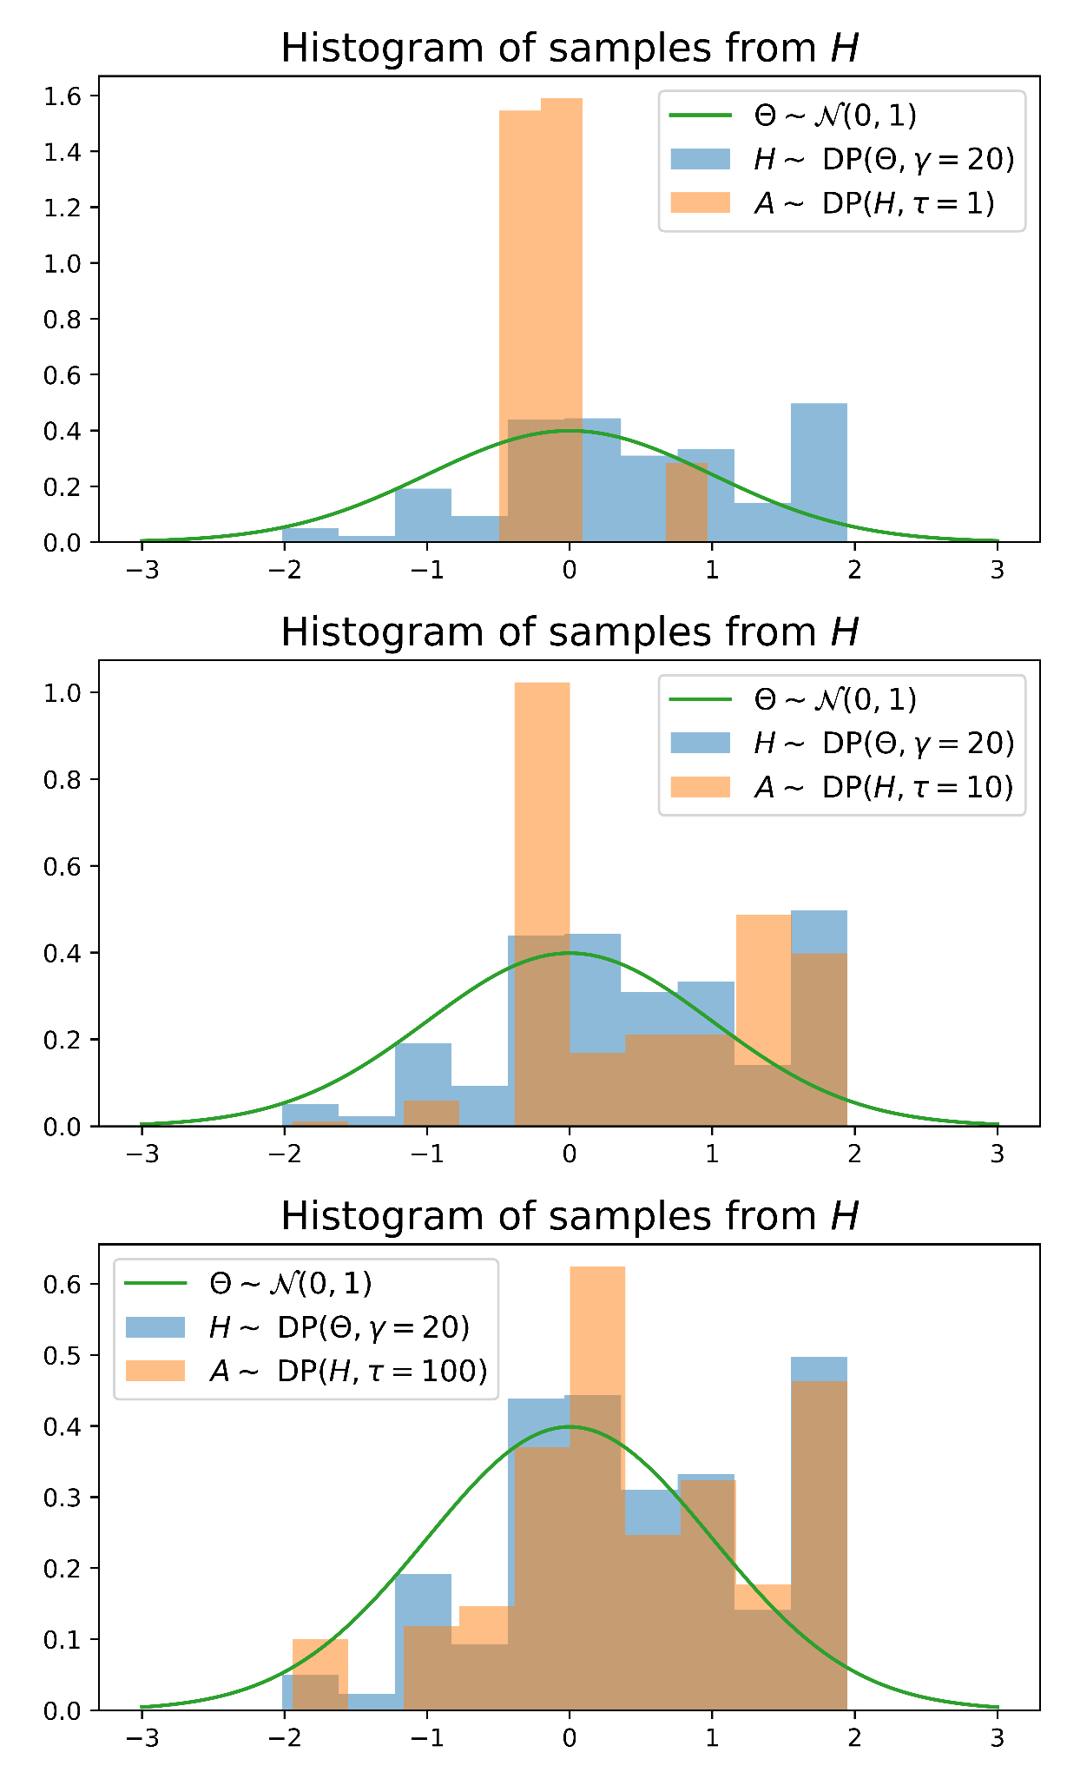
Notes:
The information contained in these edges depends on their sequential order.
https://en.wikipedia.org/wiki/Hierarchical_Dirichlet_process
Chong Wang, 2011: the base distribution is a symmetric Dirichlet over the vocabulary simplex;
In practice, however, drawing a concrete distribution is impossible, since its specification requires an infinite amount of information.
theta_i are samples from the base distribution Theta, \delta_theta_i is an indicator function centered on theta_i (zero everywhere except for) and the \beta _i are defined by a recursive scheme that repeatedly samples from the beta distribution.
HDP simulation code: https://colab.research.google.com/drive/1b9Cgkf7AiSdZdbN3VOjZVczCIzDFxked?usp=sharing

Slide 9
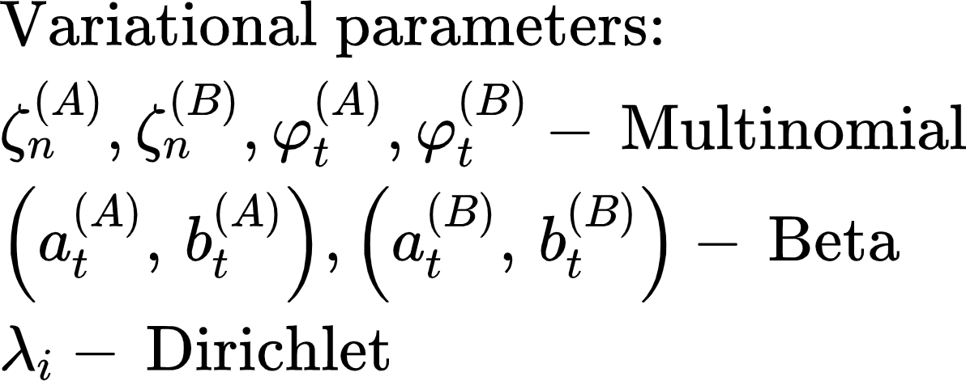
Notes:
ELBO is a lower bound of the marginal log likelihood of the observed data

Slide 10
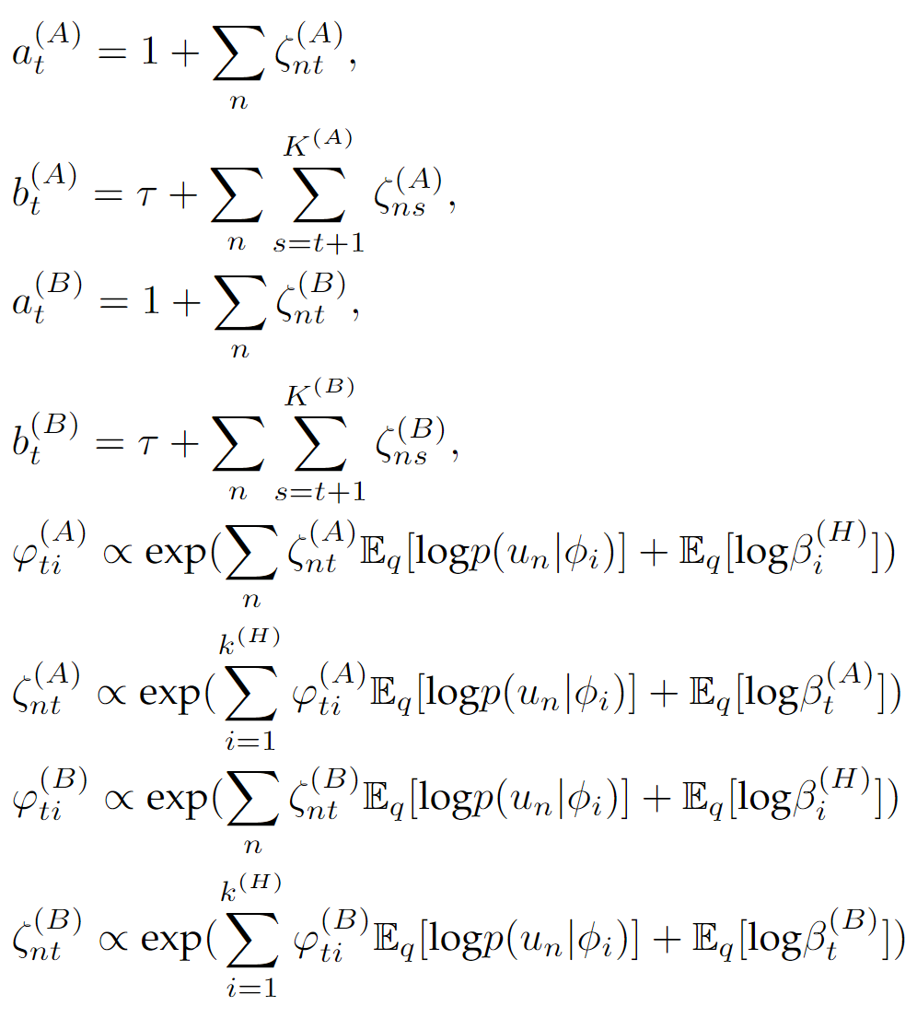
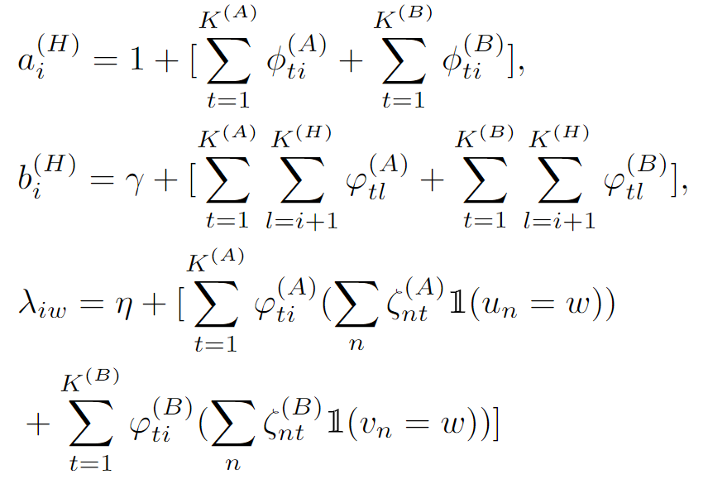

Slide 11
Conformal Prediction for Anomaly Edge Detection
Under the null hypothesis, the non-conformity score, defined as the negative posterior probability of an edge, is uniformly distributed.
Spring 2023, Ryan Tibshirani
Notes:
mixtures of i.i.d.: This Representation Theorem shows how statistical models emerge in a Bayesian context: under the hypothesis of exchangeability of the observables {Xi}∞i=1 , there is a parameter Θ such that, given the value of Θ , the observables are conditionally independent and identically distributed.

Slide 13
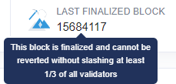
Blockchain Application: Detecting Anomalous Transactions
…
A->B
B->C
A->D
A->C
Block No./Time
About 50 blocks to be safe
About 80 blocks to be finalized

Slide 14
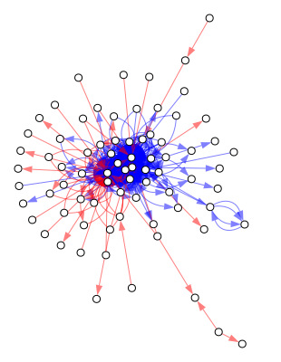
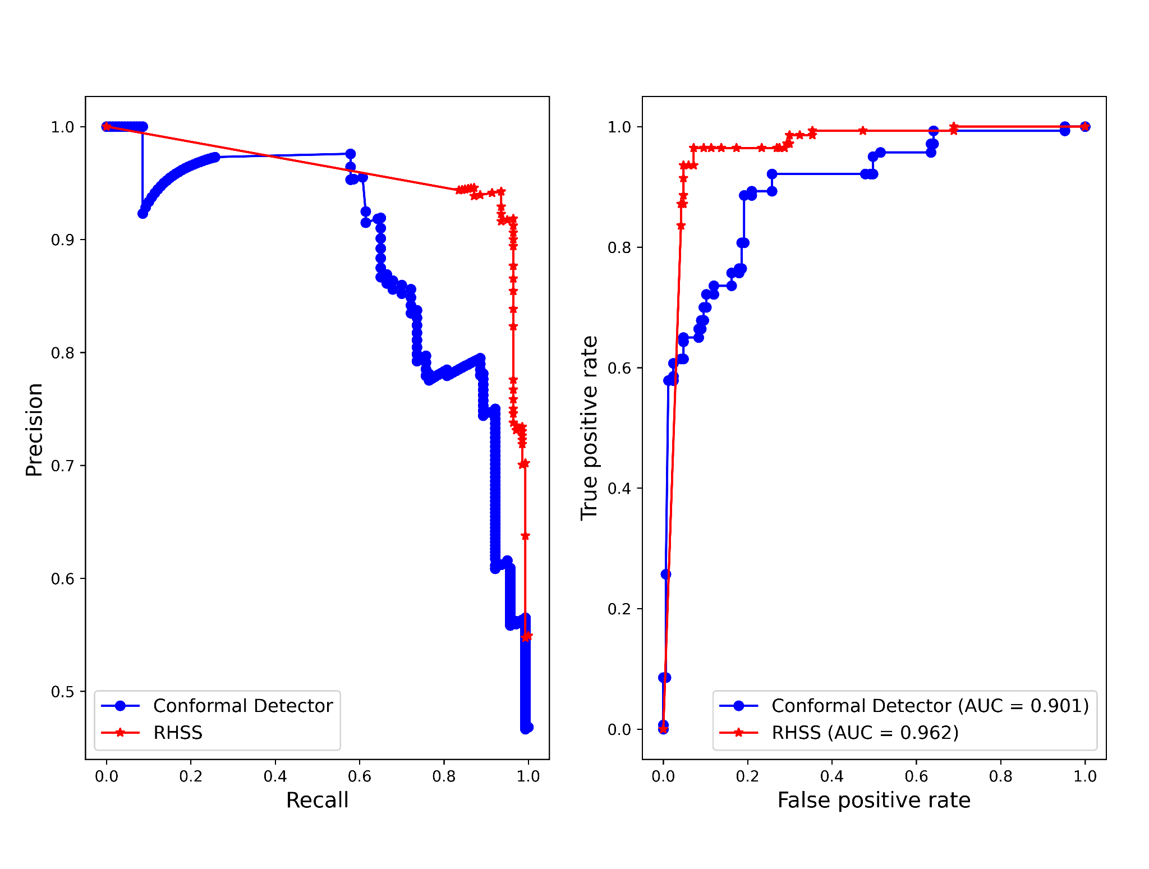
Network Structure and PR-curve, ROC-curve

Slide 15
Vikram Krishnamurthy
Cornell University
Buddhika Nettasinghe
University of Iowa

Slide 16
Anomalous Edge Detection Using Conformal Prediction and Edge Exchangeable Model

